Slide 1
Heart Disease Diagnostic Analysis
Somil Taneja

Slide 2
Introduction
Health is real wealth in the pandemic time we all realized the brute effects of covid-19 on all
irrespective of any status. You are required to analyze this health and medical data for better
future preparation.

Slide 3
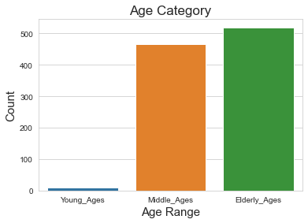
INSIGHTS
Percentage of people having heart disease= 51.31707317073171
There are more males in middle age and females in elderly age category.

Slide 4
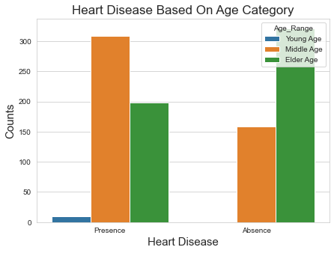
Middle ages are more prone to heart diseases.

Slide 5
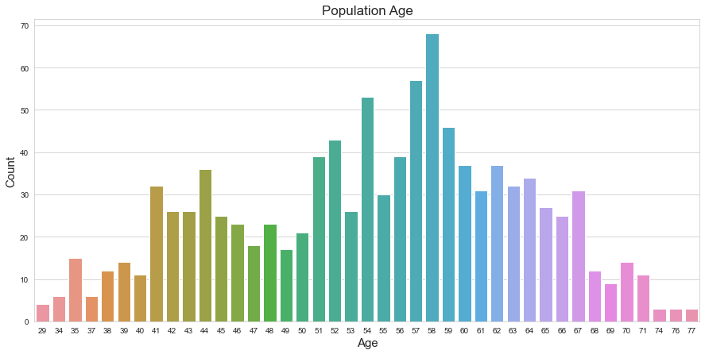
From the barplot we can tell that, people of ages 58 have highest count of suffering from heart diseases.

Slide 6
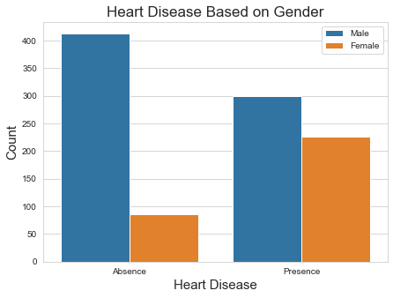
There are more males in whom heart diseases occur.

Slide 7
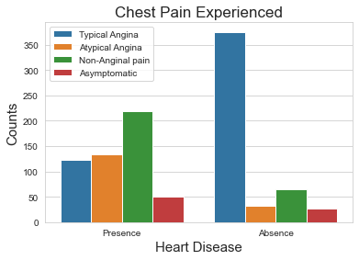
Those with Typical Angina are seen to have no occurrence of any heart disease.

Slide 8
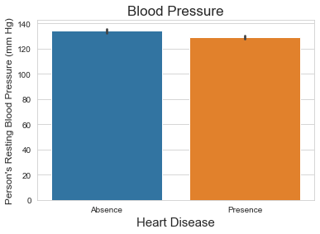
It seems a person's resting blood pressure has no relation to heart diseases in the given sample population.
In [44]:

Slide 9
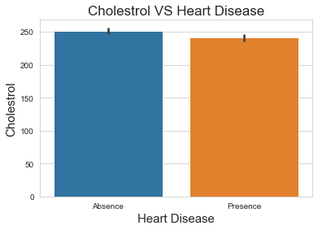
There seems to no relation to cholesterol and heart disease too in the sample population.

Slide 10
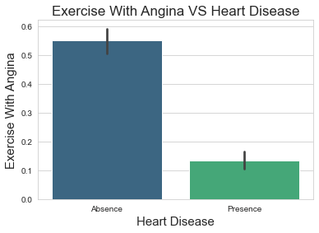
Apparently people who suffering from Angina due to exercise are not likely to not get any heart diseases in the given dataset.

